Slide 1
THE KNEE JOINT
BY
DR OJEWALE AO

Slide 2
Outline
Intro’
The Articular surface
The fibrous capsule
The synovial membrane
Ligaments
Relations
Movements
Locking and unlocking of the knee
Stability
Blood supply
Innervation & Lymphatic drainage
Applied Anatomy

Slide 3
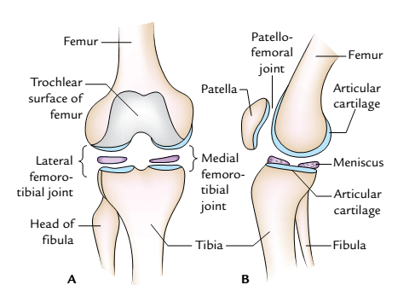
Intro’
It is the largest and most complicated joint in the body.
Is a complex hinge type of synovial joint, which essentially permits flexion and extension on a transverse axis.
Is formed between the femoral and tibial condyles and also between the femur and patella.
It has a single joint cavity (despite its complexity).
Is strengthened mainly by muscles and ligaments that are associated with it.
It is the major weight-bearing joint in the body.
A, condylar type of medial and lateral femorotibial joints; B, saddle type of patellofemoral joint.

Slide 4
Articular Surfaces
The articular surfaces of the knee joints are:
1. Articular surfaces of medial and lateral condyles of the femur.
The convex femoral condyles articulate with the concave tibial condyles.
The articular surfaces of the femoral and tibial condyles are covered by articular hyaline cartilage (to prevent friction).
2. Trochlear surface of the femur.
It is located on the anterior aspect of the lower end of the femur. It articulates with the posterior surface of the patella. It is pulley-shaped, consisting of medial and lateral sloping surfaces meeting with each other in a median vertical groove. The lateral sloping surface is longer than that of medial sloping surface.

Slide 5
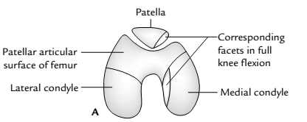
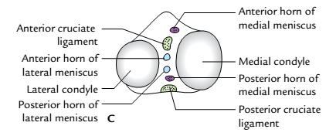
3. Articular surface of the patella.
It is on the posterior aspect of patella and articulates with the trochlear surface of the femur. It has a larger lateral area and a smaller medial area.
The femur also articulates with the patella (patellofemoral joint) through the concave patellar surface of femur.
4. Articular surfaces of medial and lateral condyles of the tibia
They are concave centrally but flattened peripherally (where each is covered by the corresponding meniscus.
The presence of a meniscus on each tibial condyle helps to deepen the concavity of the articular surface of this condyle.
superior aspect of the tibia
Inferior aspect of the patella and lower end of the femur

Slide 6
The fibrous capsule of the knee joint
forms a strong investment for the joint.
It is complex, being thin and deficient in some regions but strenghtened by ligaments elsewhere.
It is deficient posterolaterally, where the tendon of popliteus emerges from the cavity of the knee joint.
It is lined internally by a complex synovial membrane.
It is lined internally to the margins of the menisci by the short coronary ligaments.
Posteriorly, the fibrous capsule of the knee joint
It is attached above to the posterior margin of femoral condyles and intercondylar fossa.
It is attached below to the posterior margins of tibial condyles and intercondylar area.

Slide 7
Continued’
Anteriorly, the fibrous capsule of the knee joint
It is formed by the patella and ligament; hence, it is limited above by the base of the patella and below by the tibial tuberosity.
Blends, at the margins of the patella and patellar ligament, with the medial and lateral patellar retinacula; these stretch from the medial and lateral vasti respectively, to the corresponding condyles of the tibia, below.
Blends with the proximal attachment of gastrocnemius.
Is strengthened by the oblique popliteal ligament; this is an extension of the tendon of insertion of semimembranosus.
Is interrupted (deficient) where the popliteus tendon emerges from the joint cavity.

Slide 8
Continued’
Laterally, the fibrous capsule of the knee joint
Is attached above to the lateral condyle of femur, above the popliteus.
It is attached below, to the lateral condyle of tibia and head of fibula.
It is strengthened by the fibular collateral ligament (which lies lateral to it).
It is separated from the fibular collateral ligament by the inferior lateral genicular nerve and vessels.
Medially, the fibrous capsule of the knee joint
It is attached above and below to the medial condyles of the femur and tibia respectively.
Blends with, and is strengthened by the tibia collateral ligament.

Slide 9
The synovial membrane of the knee joint
It is the most complexly arranged synovial membrane in the body.
Lines the joint cavity (and thus separates the intra-articular ligaments and fat from it).
It is attached to the margins of the menisci and patella.
It is evaginated (drawn upwards) proximal to the base of the patella and deep to the tendon of quadriceps femoris to form a large suprapatellar bursa.
Covers a large infrapatellar pad of fat that lies between it and the patellar ligament (below the patella).
It is reflected from the infrapatellar pad of fat onto the margin of the patella, on each side, as the alar fold.
It is also reflected from the infrapatellar pad of fat into the intercondylar fossa of the femur as the infrapatellar fold; this is continuous anteriorly with the alar folds.

Slide 10
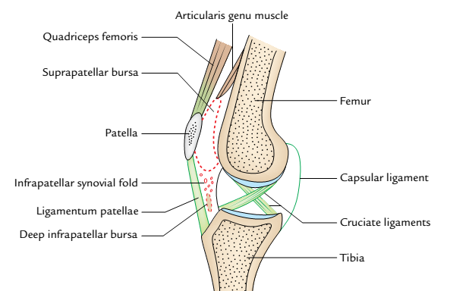
It is reflected onto the intra-articular cruciate ligaments, from the posterior aspect of the joint, thereby separating these ligaments from the joint cavity.
Forms a subpopliteal recess deep to the tendon of popliteus, (and posteroinferior to the lateral meniscus.

Slide 11
Ligaments of the knee joint
They are found within and outside the knee joint cavity.
Intracapsular ligaments of the knee joint (those within the fibrous capsule) include the anterior and posterior cruciate ligaments, transverse ligament of the knee joint, medial and lateral menisci.
Extracapsular ligaments of the knee joint (those outside the fibrous capsule) include the tibial and fibular collateral , capsular, patellar, oblique popliteal and arcuate popliteal ligaments.
The cruciate ligament
Are strong fibrous bands located within the capsule of the knee joint; they connect the tibia and femur together.
Criss-cross each other obliquely along their length.
Are two in number: anterior and posterior cruciate ligaments.
Through within the fibrous capsule of the joint, they are not exposed to the joint cavity. (as each of them is covered by synovial membrane).

Slide 12
Cont’d
The anterior cruciate ligament
Is the weaker of two cruciate ligaments.
Is attached below to the anterior intercondylar area of tibia (behind the attachment of the anterior horn of the medial meniscus.
Ascends backwards and laterally to the (posteromedial aspect of the) lateral condyle of femur, to which it is attached above.
Is more frequently involved in injuries of the knee, as does the tibial collateral ligament.
Becomes taut when the knee is fully extended; this prevents backward displacement of the femur on the tibia.
The posterior cruciate ligament
It is much stronger than the anterior cruciate ligament; thus, it is less frequently damaged in knee injuries.
It is attached below to the posterior intercondylar area of the tibia (behind the lateral meniscus).
Ascends anteromedially, to be attached above to the (lateral surface of the) medial condyle of femur.
Becomes taut during flexion of the joint, thereby preventing posterior dislocation of tibia on femur.

Slide 13
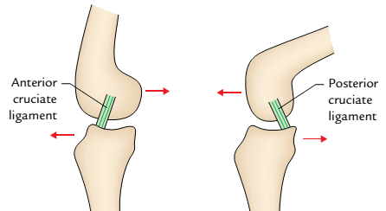

Slide 14
Menisci
Each meniscus
It is a fibrocartilagenous plate associated with the articular surface of the respective tibial condyle.
Possesses a thick convex and vascular peripheral border, which is attached to the fibrous capsule of the knee joint.
Has a thin, free concave inner border , which is avascular.
Serves as a shock absorber for the knee joint during movement.
Is joined to its fellow across the midline by the transverse ligament of the knee joint; this connects the anterior horns of the (medial and lateral) menisci.
The medial meniscus
It is roughly semicircular in outline; it is located on the medial condyle of the tibia.
It is less extensive (i.e. covers less condylar area) than the lateral meniscus.
It is attached at its periphery to the margin of the medial condyle of tibia by the coronary ligament (a reflection of the fibrous capsule.

Slide 15
Cont’d
It is also attached by its anterior horn to the anterior intercondylar area of tibia (anterior to the anterior cruciate ligament).
It is connected to the lateral meniscus by the transverse ligament of knee; and it stretches between the anterior ends of the two menisci.
Is attached posteriorly, through its posterior horn, to the posterior intercondylar area of the tibia. (behind the attachment of the lateral meniscus).
Is less freely movable than the lateral meniscus; hence, it is more frequently torn in knee injuries.
The lateral meniscus
It is almost circular in outline
It is more extensive (i.e. covers a larger area than the medial meniscus.
It is attached, through its anterior end, to the anterior intercondylar area of tibia (posterolateral to the point of attachment of the anterior cruciate ligament.
It is attached posteriorly, through its posterior end, to the posterior intercondylar area of tibia (anterior to the posterior end of the medial meniscus).

Slide 16
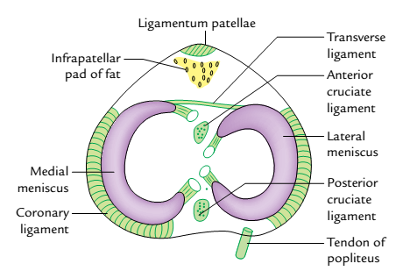
Cont’d
It is separated from the fibular collateral ligament by tendon of popliteus.
It gives rise to the posterior meniscofemoral ligament (Ligament of Wrisberg). This stretches superomedially from the posterior end of the lateral meniscus to the medial condyle of the femur.
It may give rise to an anterior meniscofemoral ligament (Ligament of Humphrey); this also stretches superomedially from the posterior end of the lateral meniscus to the medial condyle of femur (anterior to the posterior cruciate ligament).
It is less frequently injured (owing to its ability to move more freely).
Medial and lateral menisci of the knee joint

Slide 17
Functions of the menisci
The menisci increase the concavities of the tibial condyles for better harmony with the femoral condyles.
They act as swabs to lubricate the joint cavity.
They act as shock absorber to protect the articular cartilage during weight transmission.
They adapt to the varying curvatures of the different parts of the femoral condyles.
The transverse ligament of the knee joint
It connects the anterior ends of the medial and lateral menisci across the midline.
It varies in thickness and may be absent.

Slide 18
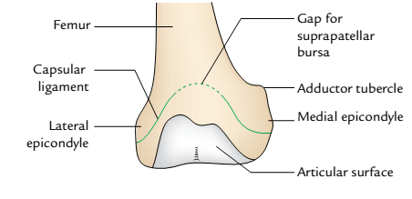
Extracapsular ligaments of the knee joint
Patellar ligament
It is the strong flat distal part of quadriceps femoris tendon; it measures about 8 cm in length; thus, it
It is continous proximally with the tendon of quadriceps femoris, anterior to the patella.
It Stretches from the apex of the patella above, to the tibial tuberosity below.
It forms the anterior part of the fibrous capsule of the knee joint (below the patella); an infrapatellar pad of fat separates it from the synovial membrane of the joint.
Capsular ligament: It is a thin fibrous sac which surrounds the joint. It is deficient anteriorly, where it is replaced by the patella, quadriceps femoris, medial and lateral patellar retinacula, and ligamentum patellae.

Slide 19
Continued’
Is flanked at the sides by medial and lateral patellar retinacula (from the tendons of the medial and lateral vasti respectively.
Is separated from the tibia by the deep infrapatellar bursa , over which it slides.
The tibial collateral ligament
Is a flat broad fibrous band that strengthens the fibrous capsule of the knee joint medially. A bursa may separate it from the capsule.
Stretches from the medial epicondyle of femur above, to the medial condyle of tibia, medial meniscus and upper part of the medial surface of the tibia, below.

Slide 20
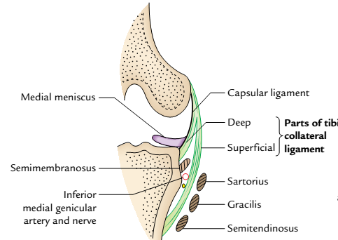
Continued’
It is separated from the tendons of semitendinosus, gracilis and sartorius (at its distal tibial attachment) by the bursa anserina.
Sends some fibres from its deep surface- the deep fibres of tibial collateral ligament to the medial meniscus.
It is weaker than the fibular collateral ligament; hence, it is more frequently torn
It measures about 10 cm in length.

Slide 21
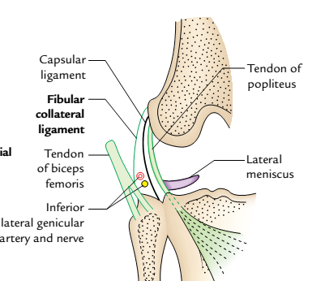
The fibular collateral ligament
Is a strong fibrous cord; it is much stronger than the tibial collateral ligament.
Stretches from the lateral epicondyle of femur above, to the head of the fibula below.
Strengthens the fibrous capsule of the knee joint laterally; it is separated from this capsule by the tendon of popliteus and the inferior lateral genicular nerve and vessels.
Thus it is not attached to the lateral meniscus of the knee joint by any fibrous tissue.
Pierces the tendon of bicep femoris near its fibular attachment.
Is less commonly torn in knee injuries.

Slide 22
Cont’d
The oblique popliteal ligament
Is an extension of the tendon of insertion of semimembranosus
Stretches superolaterally, behind the knee joint, from the posterior aspect of the medial condyle of the tibia to the lateral condyle of femur.
Blends with the fibrous capsule of the knee joint, which it strengthens posteriorly
Forms part of the floor of the popliteal fossa.
The arcuate popliteal ligament
Arises from the head of fibula below; it then arches upward and medially, superficial to the tendon of popliteus, to blend with the fibrous capsule of the knee joint.
Strengthens the fibrous capsule of the knee joint posteriorly.

Slide 23
BURSAE AROUND THE KNEE
There are about 12 bursae around the knee, four anterior, three lateral, three medial, and two posterior.
Anterior Bursae: Subcutaneous prepatellar bursa (bursa of housemaid’s knee). It lies deep to the skin in front of lower half of the patella and upper half of the ligamentum patellae and tibial tuberosity.
Subcutaneous infrapatellar bursa between the skin and smooth lower part of the tibial tuberosity.
Deep infrapatellar bursa, between ligamentum patellae and tibial tuberosity.
Suprapatellar bursa between the anterior surface of lower part of the femur and deep surface of the quadriceps femoris.

Slide 24
Cont’d
Lateral Bursae
These are:
The bursa between the fibular collateral ligament and tendon of biceps femoris.
The bursa between the fibular collateral ligament and tendon of popliteus.
The bursa between the tendon of popliteus and lateral condyle of femur. This bursa is really a synovial tube around the tendon of popliteus; hence it communicates with the joint cavity.
Medial Bursae
These are:
The bursa, which separates the tendons of sartorius, gracilis, and semitendinosus from each other and from the tibial collateral ligament (bursa anserine).
The bursa between the tendon of semimembranosus and medial collateral ligament.
The bursa between the tendon of semimembranosus and medial condyle of the tibia. It may communicate with the knee joint.

Slide 25
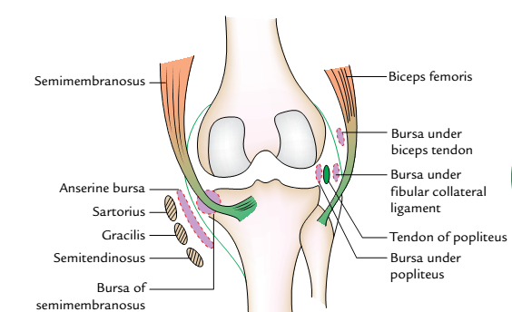
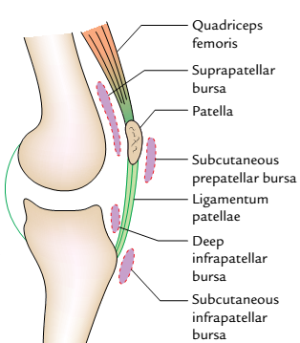
bursae on the front of the knee
Bursae around the knee joint: A,bursae on the medial and lateral aspects of the knee

Slide 26
Cont’d
Relations of the Knee Joint
Anteriorly: Tendon of the quadriceps femoris, patella, ligamentum patellae, patellar plexus of the nerves, and prepatellar synovial bursa.
Anteromedially: Medial patellar retinaculum.
Anterolaterally: Lateral patellar retinaculum and iliotibial tract.
Posteriorly: Popliteal vessels, tibial nerve, and oblique popliteal ligament.
Posterolaterally: In the upper part, tendon of biceps femoris and common peroneal nerve; in the lower part, lateral head of gastrocnemius and plantaris.
Posteromedially:In the upper part, sartorius, gracilis, semimembranosus, and semitendinosus.
Posterior Bursae
These are:
The bursa between the lateral head of gastrocnemius and capsule of the joint.
The bursa between the medial head of gastrocnemius and capsule of the joint (Brodie’s bursa).

Slide 27
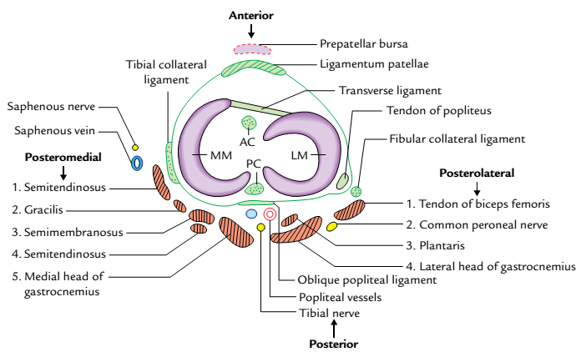
BLOOD SUPPLY
It is richly supplied by the blood through the arterial anastomosis around the knee, which is formed by: (a) five genicular branches of popliteal artery, (b) descending genicular branch of femoral artery, (c) descending branch of the lateral circumflex femoral artery, (d) of the anterior tibial artery, and (e) circumflex fibular branch of the posterior tibial artery.
Relations of the knee joint (transverse section of right knee joint)

Slide 28
NERVE SUPPLY
The knee joint has rich nerve supply by:
(a) Femoral nerve through its branches to vasti, especially to vastus medialis.
(b) Tibial and common peroneal nerves through their genicular branches.
(c) Obturator nerve through its posterior division
MOVEMENTS
The following movements occur at the knee joints:
Flexion
Extension
Medial rotation
Lateral rotation.

Slide 29
Movements of the knee joint
 | Muscles producing movements
Movements | Chief muscles | Accessory muscles
Flexion | Semimembranosus Semitendinosus Biceps femoris | Popliteus (initiates flexion) Sartorius Gracilis Gastrocnemius Plantaris
Extension | Quadriceps femoris | Tensor fasciae latae
Medial rotation | Semitendinosus Semimembranosus Popliteus | Sartorius Gracilis
Lateral rotation | Biceps femoris | Gluteus maximus Tensor fasciae latae

Slide 30
Factors Maintaining the Stability of the Knee Joint
The stability of the knee joint is maintained by the following factors:
Strength and actions of the surrounding muscles and tendons.
Medial and lateral collateral ligaments maintain side-to side stability.
Cruciate ligaments maintain anteroposterior stability.
Iliotibial tract helps in stabilizing a partly flexed knee

Slide 31
Locking and unlocking of the knee
Locking of the knee: When the foot is on the ground, the locking is defined as the medial rotation of femur on the tibia during the terminal phase of extension of the knee. When the knee is locked it becomes absolutely rigid and all the ligaments of the joint are taut. This is known as “screw home mechanism”.
Unlocking of the knee: When the foot is on the ground, the unlocking is defined as the lateral rotation of the femur on the tibia during initial phase of the flexion. The unlocking is brought about by the popliteus muscle.
When the knee is unlocked, it can be further flexed by the hamstring muscles.
The locking of knee is essential for bearing load during erect posture. The locked joint must be unlocked to facilitate progress of locomotion. Hence, during locomotion, locking and unlocking of the knee takes place alternatively and rhythmically.

Slide 32
The differences between the locking and unlocking of the knee
Locking of the knee joint | Unlocking of the knee joint
Medial rotation of the femur on tibia during terminal phase of extension | Lateral rotation of the femur on tibia during initial phase of the flexion
It is brought about by quadriceps femoris | It is brought about by the popliteus muscle
Locked knee becomes absolutely rigid | Unlocked knee can be further flexed
All ligaments are taut | All ligaments are relaxed

Slide 33
Applied Anatomy
Meniscal tears: The injuries to menisci are commonly caused by the twisting strains in a slightly flexed knee, as in kicking a football. The meniscus may get separated from the capsule, or it may be torn longitudinally or transversely.
The medial meniscus is more prone to injury than the lateral meniscus because of its fixedness to tibial collateral ligament, and greater excursion during the rotatory movements. The lateral meniscus is protected by the popliteus muscle because its medial fibres pulls the posterior horn of meniscus backward, so that it is not crushed between the articular surfaces. Pain on the medial rotation of tibia on the femur indicates injury of the medial meniscus; while pain on the lateral rotation of tibia on the femur indicates injury of the lateral meniscus.

Slide 34
Cont’d
Housemaid’s knee: It is the inflammation of the prepatellar bursa (prepatellar bursitis). It occurs due to friction of bursa against the patella when it comes in contact with the ground during scrubbing of the floor by the housemaid. Such a bursa may get very large and drop by its weight to much below to its original position.
Baker’s cyst (also known as popliteal cyst) : The chronic inflammation of bursa deep to semimembranosus may present as cystic swelling in the medial part of the popliteal fossa called Baker’s cyst.
Excessive (synovial) fluid in the knee joint may arise from chronic effusion; this may result in herniation of the synovial membrane into the popliteal fossa- popliteal cyst
Clergyman’s knee: It is the inflammation of subcutaneous infrapatellar bursa (subcutaneous infrapatellar bursitis). It occurs due to the friction of bursa against the tibial tuberosity due to kneeling (e.g., kneeling during prayer by Christian & Muslim priests/clergymen, roofers, and floor tilers).

Slide 35
Cont’d
Osteoarthritis: It is commonly involved in osteoarthritis (degenerative wear and tear of articular cartilages), being a weight-bearing joint. The movements may be painful, limited, and produce grating. Radiographs of the knee region reveal osteophytes, i.e., peripheral lipping of the articular ends.
Injuries to cruciate ligaments: The anterior cruciate ligament is more commonly damaged than the posterior ligament.
The anterior cruciate ligament is injured in the anterior dislocation of the tibia; whereas, the posterior ligament is injured in the posterior dislocation of the tibia. Tear of the cruciate ligaments leads to abnormal anteroposterior mobility.
If the anterior cruciate ligament is torn the tibia is pulled excessively forward on the femur (anterior drawer sign) and if the posterior cruciate ligament is torn the tibia is pulled excessively backward on the femur (posterior drawer sign).

Slide 36
Cont’d
Arthroscopy of the knee joint: It is an endoscopic examination (visualization) of the interior of the knee joint cavity with minimal disruption of the tissues. The ligament repair or replacement can also be performed by using an arthroscope.
Knee replacement: If the knee joint is badly damaged by the osteoarthritis, an artificial joint consisting of plastic tibial component and metal femoral component is connected to the tibial and femoral bone ends after removal of the damaged areas.
Unhappy triad of the knee joint: A combination of injury of the (a) tibial collateral ligament, (b) medial meniscus, and (c) anterior cruciate ligament is called “unhappy triad” of the knee joint.

Slide 37
Cont’d
Aspiration of the knee joint: The collections of fluid are common in the knee joint. It gives rise to swelling above and at the sides of the patella. In such cases, patellar tap often demonstrates a floating patella. Aspiration of the fluid can be done on either side of the ligamentum patellae. But the joint is usually approached from its lateral side using three bony points as landmarks for the needle insertion:
(a) tibial tuberosity, (b) lateral epicondyle of the femur, and (c) apex of patella. This triangular area is also used for drug injection in treating the knee pathology.
Excessive (synovial) fluid in the knee joint may arise from chronic effusion; this may result in herniation of the synovial membrane into the popliteal fossa- popliteal cyst

Slide 38
THANK YOU, ALL FOR LISTENING.

Slide 39


